Slide 1
WELCOME TO THE ESNO CONGRESS
5 - 7 JUNE 2024

Slide 2
5 – 7 June, Milan Italy
WWW.ESNO-CONGRESS.EU
"The Specialist Nurse in European Healthcare towards 2030“. Nursing preparedness and readiness for European Health

Slide 3
THIS IS ESNO
A strong and enthusiastic nurses' community of all specialisations and advanced levels across Europe.

Slide 4
REGISTER TODAY FOR FREE
WWW.ESNO.ORG/MEMBERS

Slide 5
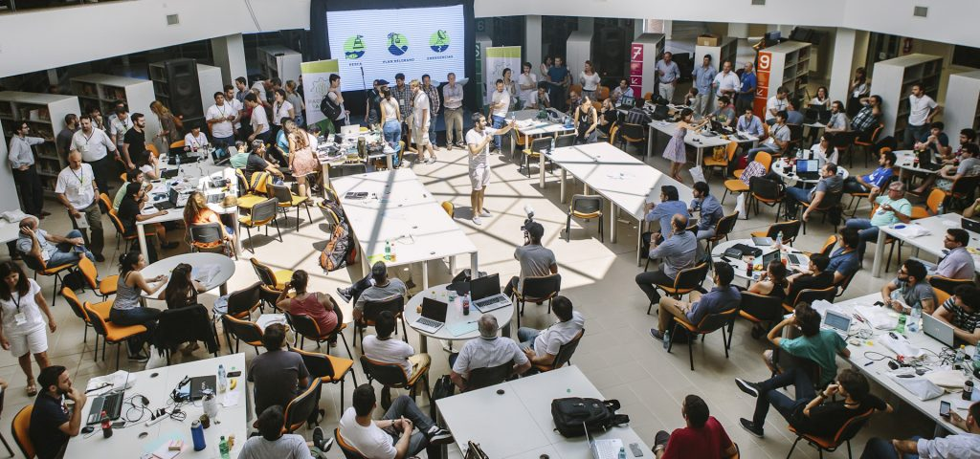
5 JUNE 2024 - HACKATHON
“SOLVING THE HEALTHWORKFORCE CRISIS FROM THE NURSES PERSPECTIVE IN ONE DAY”
“ARE YOU READY FOR THE CHALLENGE?”

Slide 6
This event was made possible with support

